Slide 1
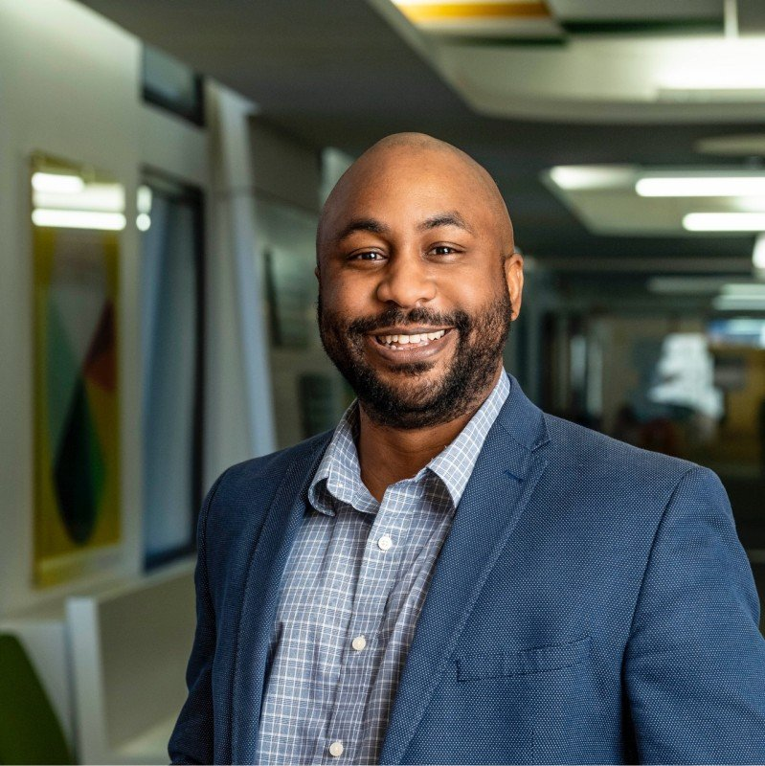




OL 3020 – Leadership Foundations
Lessons of
Leadership
Dr. Emanuel O. Clayton, Ph.D.
Assistant Director – Academic Success
Student Success Center, Wright State University
Known Since 2024
Working Since Spring 2025
Math Learning Center
Utsav Acharya | March 12, 2026
SLIDE 1 OF 4

Slide 2


LEADERSHIP STRENGTH
Developer
CliftonStrengths (Rath, 2007)
DEFINITION
Developers recognize and cultivate the potential in others. They notice even small signs of growth and find genuine satisfaction in helping people improve.
Hires Strategically
Trains for Growth
Models Encouragement
Dr. Clayton carefully selects tutors who are patient and skilled to build a strong support team.
He trains tutors for both in-person and online sessions, preparing them for professional work.
Even when students make repeated mistakes, he responds with a smile and motivates them forward.
Utsav Acharya | OL 3020 | Wright State University
2 / 4

Slide 3
VISION IN PRACTICE
Implements a Vision
Northouse, 2025, Ch. 7
THE VISION
Build student independence in mathematics — strengthen foundational skills so students no longer rely on others for answers.
Hire the Right Tutors
Train Online & In-Person
Guide, Don't Give Answers
01
02
03
Selects tutors with both subject knowledge and the patience to guide students.
Prepares tutors to support students in any format, building professional readiness.
Tutors walk students through their thinking process to develop lasting independence.
Utsav Acharya | OL 3020 | Wright State University
3 / 4

Slide 4
REFERENCES
Northouse, P. G. (2025). Introduction to leadership: Concepts and practice (6th ed.). Sage Publications.
Textbook
Rath, T. (2007). StrengthsFinder 2.0. Gallup Press.
CliftonStrengths
Clayton, E. O. (2025). Wright State University faculty profile. https://people.wright.edu/emanuel.clayton
Leader Profile
Utsav Acharya | OL 3020 | Wright State University | March 12, 2026

